Slide 1
19Z604 Embedded Systems
Dr.N.Arulanand,
Professor,
Dept of CSE,
PSG College of Technology

Slide 2
Real Time Operating Systems
REAL TIME OPERATING SYSTEMS: Real-Time Concepts - Task Management - Task Scheduling - Classification of Scheduling Algorithms - Clock Driven Scheduling - Event Driven Scheduling - Resource Sharing - Priority Inheritance Protocol - Priority Ceiling Protocol Commercial RTOS – VxWorks

Slide 3
What is Real Time ?
A system is called a real-time system, when we need quantitative expression of time (i.e. real-time) to describe the behavior of the system
A chemical plant, whose part behavior description is - when temperature of the reaction chamber attains certain predetermined temperature value, say 250ºC, the system automatically switches off the heater within say 30 milliseconds - is clearly a real-time system.

Slide 4
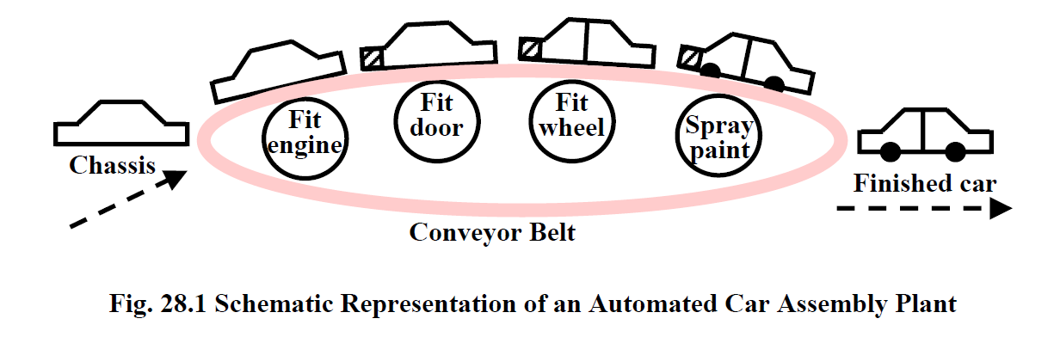
Applications of Real-Time
Industrial Applications
Chemical Plant Control
Automated Car Assembly Plant
Medical
Robot Used in Recovery of Displaced Radioactive Material
Automotive &Transportation
Multi-Point Fuel Injection (MPFI) System : An automotive engine control system, that controls the rate of fuel injection and allows the engine to operate at its optimal efficiency
Defense Applications
Missile Guidance System

Slide 5
Characteristics of Real-time system
Time constraints
Every real-time task is associated with some time constraints. One form of time constraints that is very common is deadlines associated with tasks.
New Correctness Criterion
In real-time systems, correctness implies not only logical correctness of the results, but the time at which the results are produced
A logically correct result produced after the deadline would be considered as an incorrect result.
Safety-Criticality
For traditional non-real-time systems safety and reliability are independent issues. However, in many real-time systems these two issues are intricately bound together making them safety-critical
a safe system is one that does not cause any damage even when it fails.
A reliable system on the other hand, is one that can operate for long durations of time without exhibiting any failures.

Slide 6
Hard Real-time System
A hard real-time task is one that is constrained to produce its results within certain predefined time bounds.
The system is considered to have failed whenever any of its hard real-time tasks does not produce its required results before the specified time bound.

Slide 7
Soft Real-Time System
Soft real-time tasks also have time bounds associated with them.
However, unlike hard real-time tasks, the timing constraints on soft real-time tasks are not expressed as absolute values.
Instead, the constraints are expressed either in terms of the average response times required.

Slide 8
Basic Terminologies
Task Instance
Each time an event occurs, it triggers the task that handles this event to run
Real-time tasks therefore normally recur a large number of times at different instants of time depending on the event occurrence times.
It is possible that real-time tasks recur at random instants.
However, most real-time tasks recur with certain fixed periods.

Slide 9
Types of Task
Periodic Task:
A periodic task is one that repeats after a certain fixed time interval.
T_{i} = ( e _{i}, pi, d_{i}) Highly critical
Sporadic Task:
A sporadic task is one that recurs at random instants. A sporadic task Ti can be is represented by a three tuple: T_{i} = ( e _{i}, g _{i}, d_{i})
Critical to Normal
Aperiodic Task
An aperiodic task can arise at random instants . the minimum separation gi between two consecutive instances can be 0
Low priority
where e^{i} is the worst case execution time of an instance of the task, g^{i} denotes the minimum separation between two consecutive instances of the task, d^{i} is the relative deadline.

Slide 10
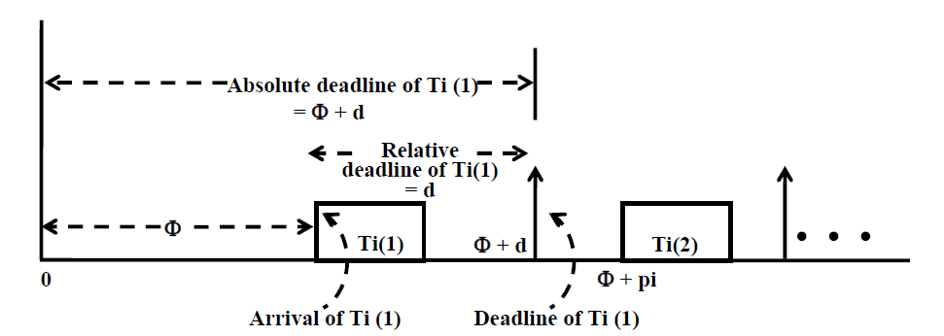
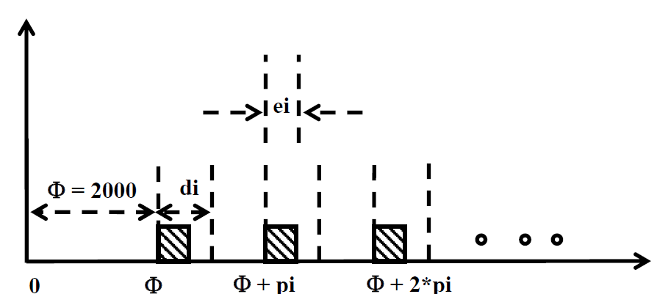
Task terminologies

Slide 11
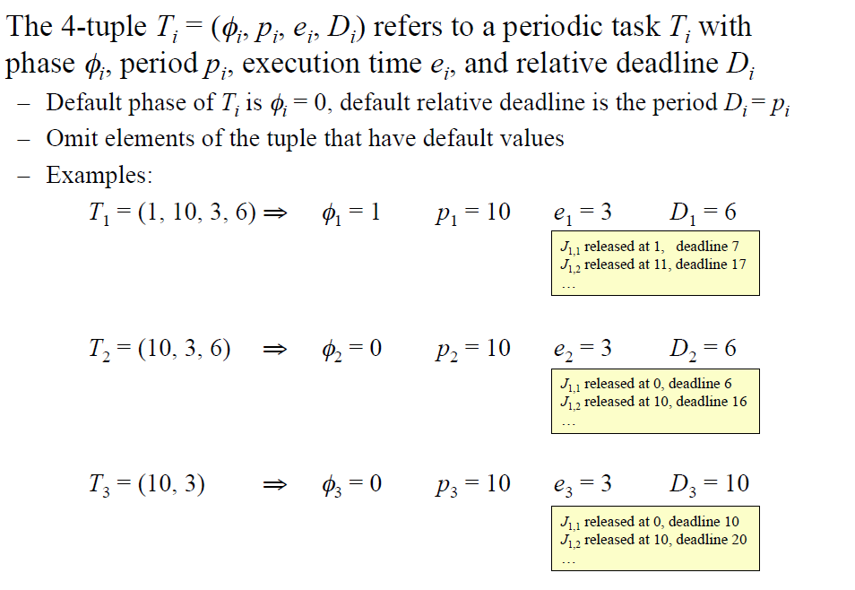
Notation

Slide 12
Types of Schedulers
1. Clock-driven Schedulers : based on clock interrupt.
1.1 Table driven
1.2 Cyclic Scheduler
2. Event-driven Schedulers
2.1 RMA (Rate Monotonic Analysis)
2.2 EDF (Earliest Deadline First)
2.3 DMA (Deadline Monotonic Analysis)
3. Hybrid
Round-robin

Slide 13
Clock-driven Schedulers
Clock-driven schedulers make their scheduling decisions regarding which task to run next only at the clock interrupt points.
The scheduling points are determined by timer interrupts
Handle only periodic tasks.
They are simple and efficient.
Easy to implement
A.k.a. Off-line Schedulers because these schedulers fix the schedule before the system starts to run.

Slide 14
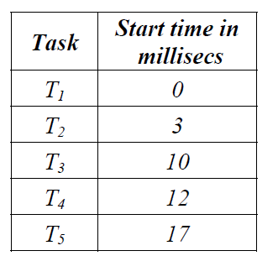
1.1 Table Driven Scheduler
Pre-compute which task would run and when.
Store this schedule in a table
Storage capacity
Q: what would be the size of the schedule table ?
if a set ST = {Ti} of n tasks is to be scheduled, then the entries in the table will replicate themselves after LCM (p1, p2… ,pn) time units, where p1, p2 …pn are the periods of T1, T2…Tn

Slide 15
1.1 Table Driven Scheduler
Example:
T1 = (e1=5 msecs, p1=24 msecs),
T2 = (e2=10 msecs, p2=48 msecs)
T3= (e3=20 msecs, p3=60 msecs)
LCM (24,48,60) = 240 msec
Major Cycle: The major cycle of a set of tasks ST = {T1, T2, … , Tn} is LCM ({p1, p2, … , pn})
where p¹, p², …, p^{n} are the periods of T^{1,} T^{2,} ..., T^{n}
Table Size = LCM of {P1,P2,P3}
Task | Start Time (in ms)
T1 | 0
T2 | 5
T3 | 15
T1 | 35
T1 | 48
T2 | 53
 | ... ... 240 msec

Slide 16
Homework
Complete the table for the above example

Slide 17
1.1 Table Driven Scheduler
All parameters about jobs (execution time/deadline) known in advance
Schedule can be computed offline or at some regular time instances.
Minimal runtime overhead.
Not suitable for many applications.

Slide 18
1.2 Cyclic Scheduler
Simple, Efficient, Easy to program
Used in small Embedded Applications
Cyclic scheduler repeats a pre-computed schedule. Pre-computed schedule need to be stored for only one major cycle.
Major and Minor cycle
The major cycles in divided into one or more minor cycles
Minor cycle is aka Frame
Scheduling points occur at frame boundaries
Frame boundaries are interrupts generated by a periodic timer.

Slide 19
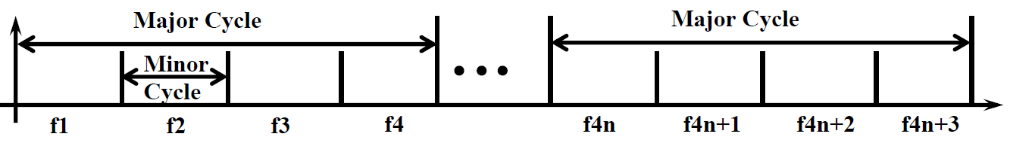
1.2 Cyclic Scheduler
Cyclic schedulers are very popular and are being extensively used in the industry.
small embedded applications
A cyclic scheduler repeats a pre-computed schedule.
The pre-computed schedule needs to be stored only for one major cycle
The major cycle has been divided into minor cycles (frames)Each minor cycle is also sometimes called a frame.
The scheduling points of a cyclic scheduler occur at frame boundaries. This means that a task can start executing only at the beginning of a frame.
The frame boundaries are defined through the interrupts generated by a periodic timer.

Slide 20
Cyclic Scheduler
Schedule task table
Size of the frame is a important design parameter. Need to chosen carefully.
Criteria for selecting Frame Size
Constraint 1: Minimum Context Switching
Constraint 2: Minimization of Table Size
Constraint 3: Satisfaction of Task Deadline
If all the constraints are satisfied, then the frame size can be selected

Slide 21
Cyclic Scheduler
Minimum Context Switching
F >= Max{ei}; F is frame size, ei is the execution time of task Ti
Min. no of context switches during task execution. i.e., a task instance must complete within the assigned frame.
If the task doesn’t complete, it needs to be suspended and restarted in a later frame.
Context switching involves processing overhead
Set the selected frame size larger than the execution time.

Slide 22
Cyclic Scheduler
Minimization of Table Size
No of entries in the schedule table should be minimum. (for minimum storage, as this is used for smaller embedded applications)
Entries can be minimised, if the Minor cycle is squarely divides the major cycle. (no fractional minor cycles)
M – major cycle
F – frame/minor cycle
Formula: If Floor(M/F) is equal to M/F
(or) M mod F = 0

Slide 23
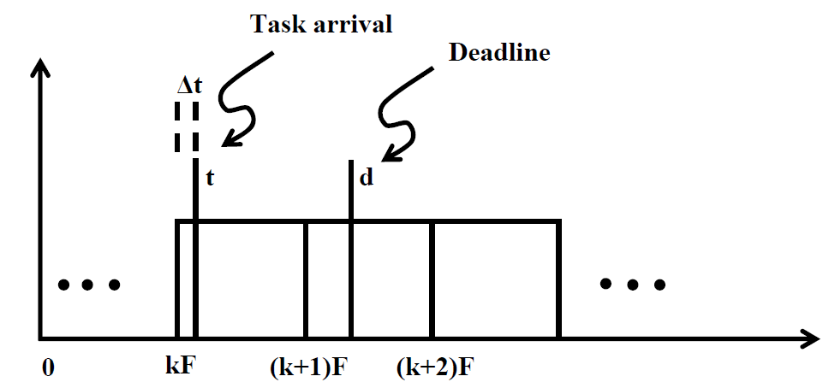
Cyclic Scheduler
Satisfaction of Task Deadline
This is needed to meet the task deadlines.
Between arrival of a task and its deadline, there must exist at least one full frame.
For every Ti,
2F – gcd(F,pi) <= di

Slide 24
Cyclic Scheduler
Exercise 1: A cyclic scheduler is to be used to run the following set of periodic tasks on a uniprocessor:
T1 = (e1=1ms, p1=4ms)
T2 = (e2=1ms, p2=5ms)
T3 = (e3=1ms, p3=20ms),
T4 = (e4=2ms, p4=20ms).
Select an appropriate frame size ?
Constraint 1: F >= max (ei)
F >= max(e1,e2,e3,e4)
F > = max(1,1,1,2)
F >= 2
Constraint 2: M mod F = 0
M = LCM(p1,p2,p3,p4)
M = LCM(4,5,20,20)
M = 20
20 mod 2 = 0
20 mod 4 = 0
....
....
F = 2,4,5,10,20

Slide 25
Cyclic Scheduler
Constraint 3: 2F – gcd(F, pi) <= di
Pi = di (if deadline is not given in the problem)
For F = 2 and Task 1:Pi = 4
2*2 – GCD(2, 4) <= 4
4 – 2 <= 4 (condition satisfied)
2 <= 4
For F = 2 and Task 2: Pi = 5
2*2 – GCD(2, 5) <= 5
4 – 1 <= 5 (condition satisfied)
For F = 2 and Task 3: Pi = 20
2*2 – GCD(2, 20) <= 20
4 – 2 <= 20 (condition satisfied)
For F=2 and Task 4: Pi = 20
2*2 – GCD(2, 20) <= 20
4 – 2 <= 20 (condition satisfied)
Thus constraint 3 is satisfied by all tasks for frame size 2. So, Frame size 2 satisfies all the three constraints. Hence frame 2 is a feasible frame

Slide 26
Cyclic Scheduler
Constraint 3: 2F – gcd(F, pi) <= di
Pi = di (if deadline is not given in the problem)
For F = 4 and Task 1:Pi = 4
2*4 – GCD(4, 4) <= 4
8 – 4 <= 4 (condition satisfied)
For F = 4 and Task 2: Pi = 5
8 – GCD(4,5) < = 5
Thus constraint 3 is NOT satisfied for frame size 4.
Hence frame 4 is NOT a suitable frame

Slide 27
Cyclic Scheduler
Exercise 1: A cyclic scheduler is to be used to run the following set of periodic tasks on a uniprocessor:
T1 = (e1=1ms, p1=4ms)
T2 = (e2=1ms, p2=5ms)
T3 = (e3=1ms, p3=20ms)
T4 = (e4=2ms, p4=20ms).
Select an appropriate frame size ?

Slide 28
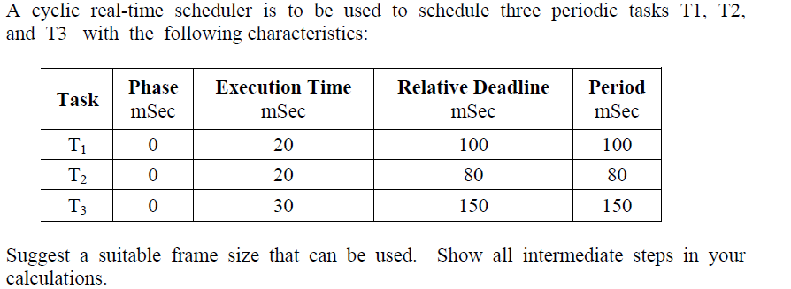
Static Cyclic Scheduler

Slide 29
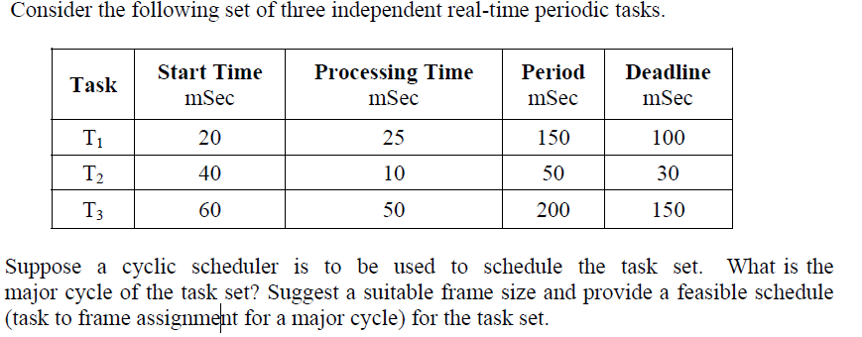
Static Cyclic Scheduler

Slide 30
Cyclic Scheduler
Consider the following set of periodic real-time tasks to be scheduled by a cyclic scheduler:
T1 = (e1=1ms, p1=4ms),
T2 = (e2=2ms, p2=5ms)
T3 = (e3=5ms, p3=20ms)
Determine a suitable frame size for the task set ?

Slide 31
Cyclic Scheduler
Exercise 3: Consider the following set of periodic real-time tasks to be scheduled by a cyclic scheduler:
T1 = (e1=1ms, p1=4ms),
T2 = (e2=2ms, p2=5ms),
T3 = (e3=5ms, p3=20ms).
Determine a suitable frame size for the task set ?
Clue:
Split into sub-tasks and find the frame
T3.1 = (1,20)
T3.2 = (2,20)
T3.3 = (2,20)

Slide 32
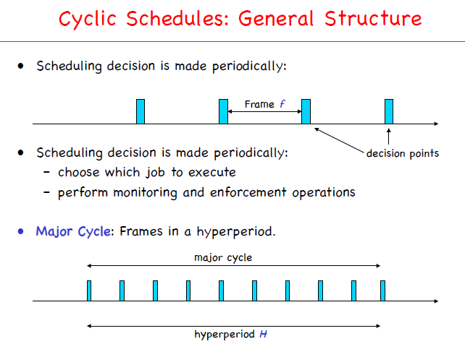

Slide 33
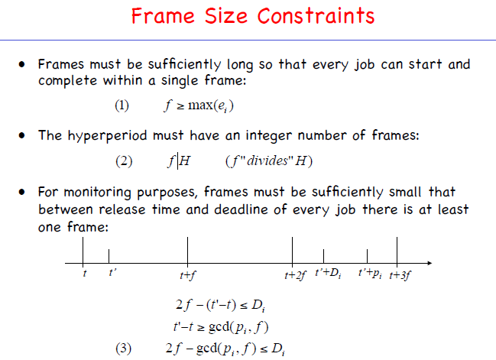

Slide 34
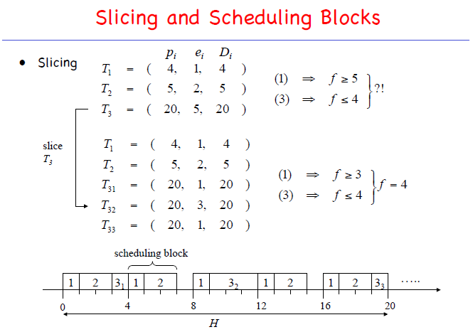

Slide 35
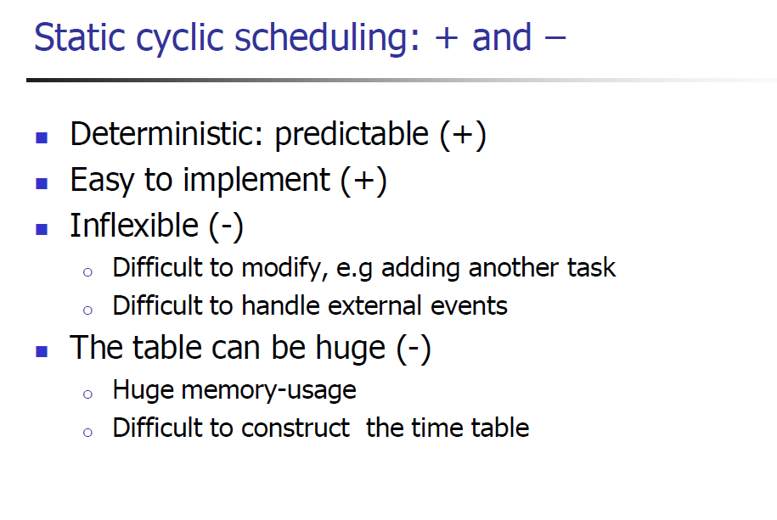

Slide 36
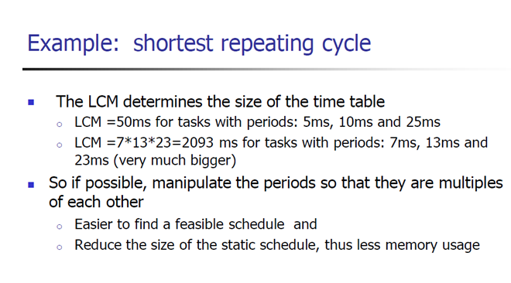

Slide 37
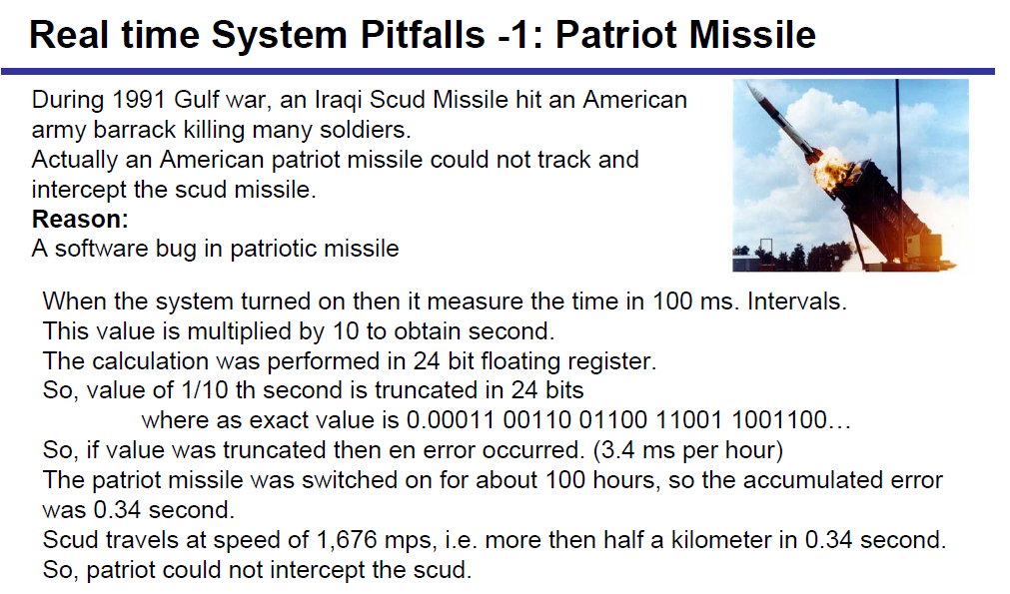
Real Time System Pitfalls

Slide 38
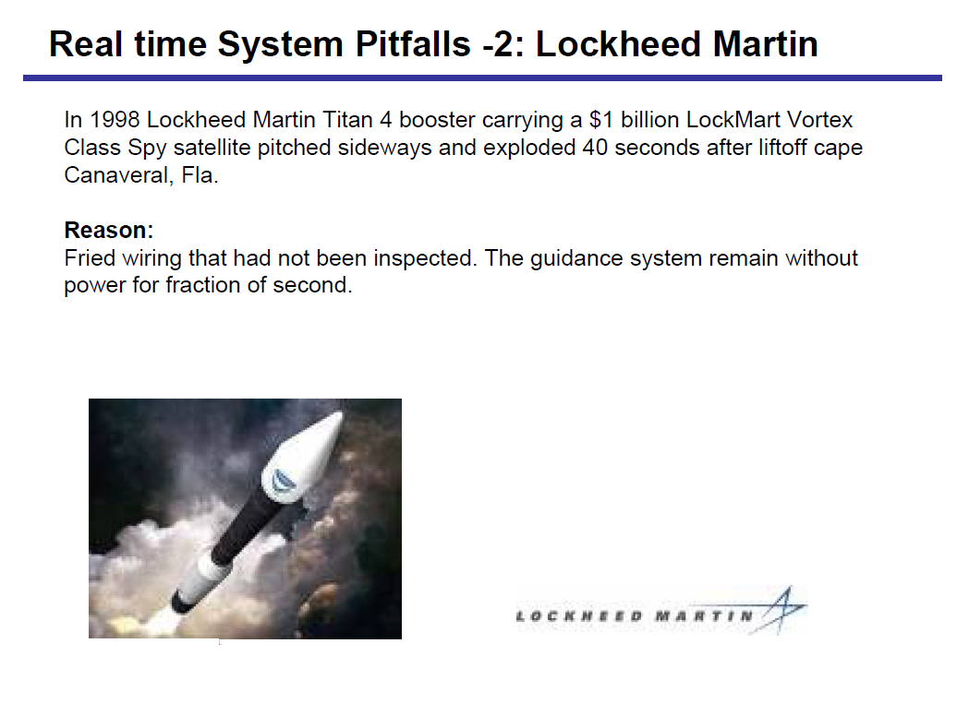

Slide 39
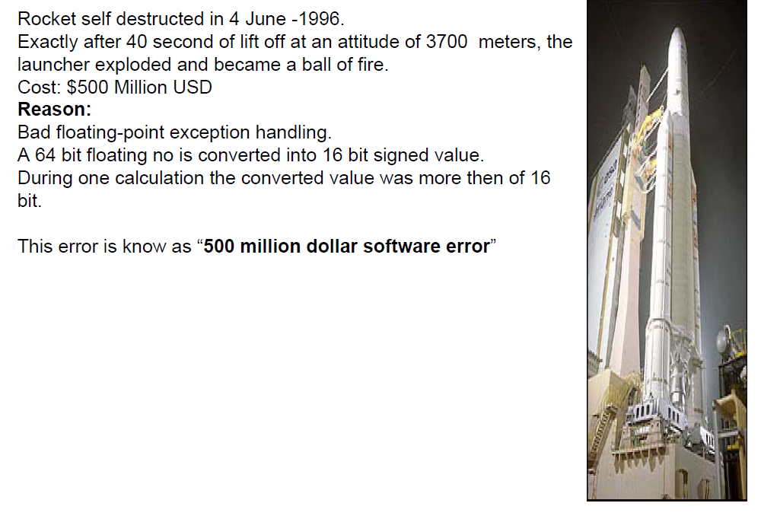
The Ariane 5 Satellite Launch Rocket

